Slide 1
K. Wah Group – AI Application for Soft Decoration Design Concept Application
Presented by: Steve Yu
Date: 30 Jan 2026

Slide 2
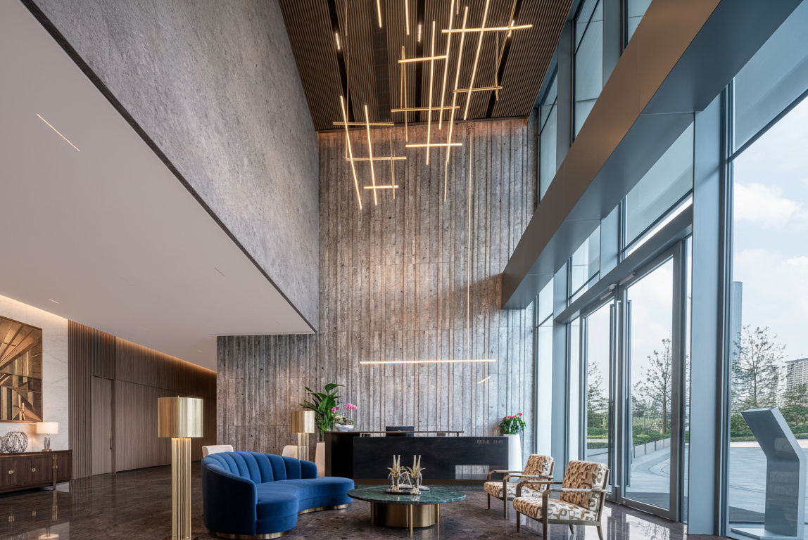
Before & After

Slide 3
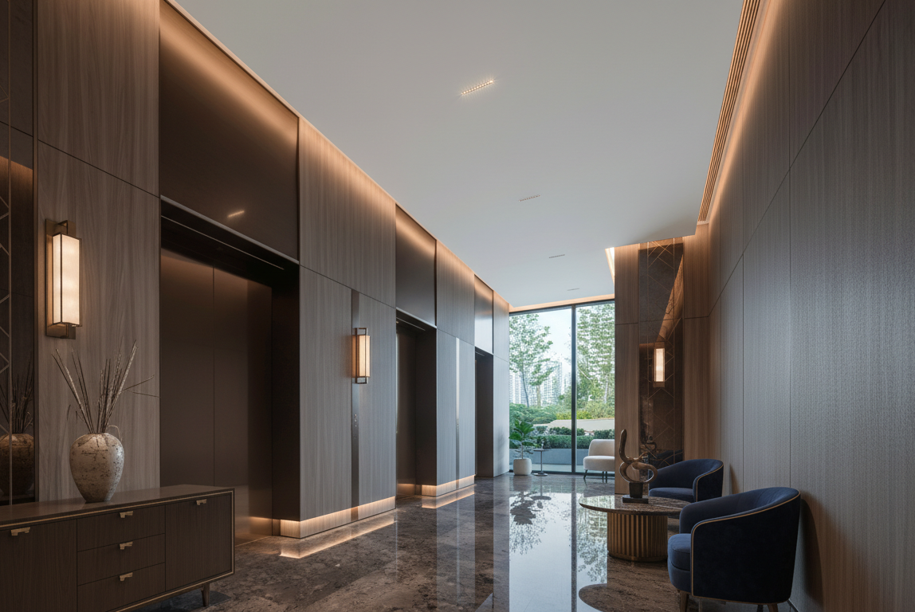
Before & After

Slide 4
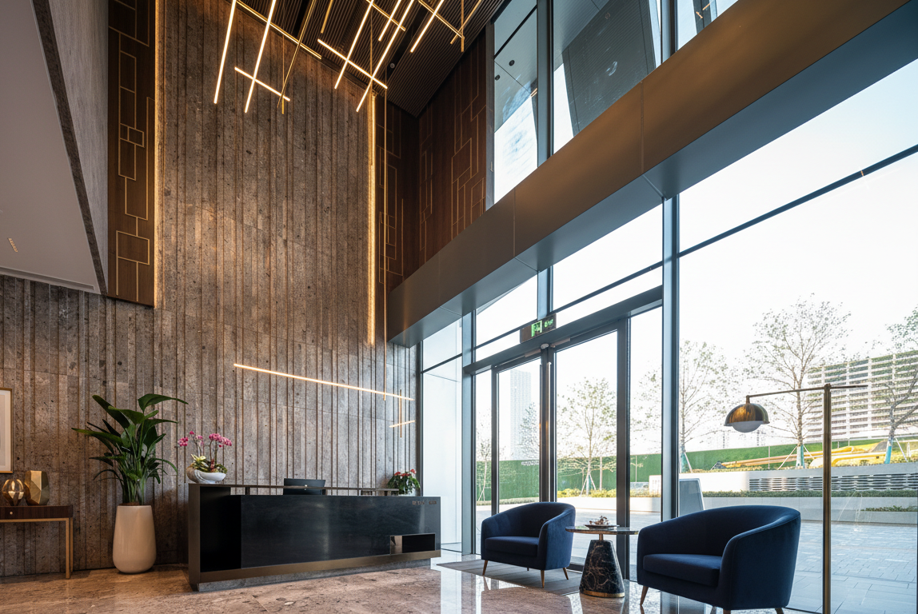
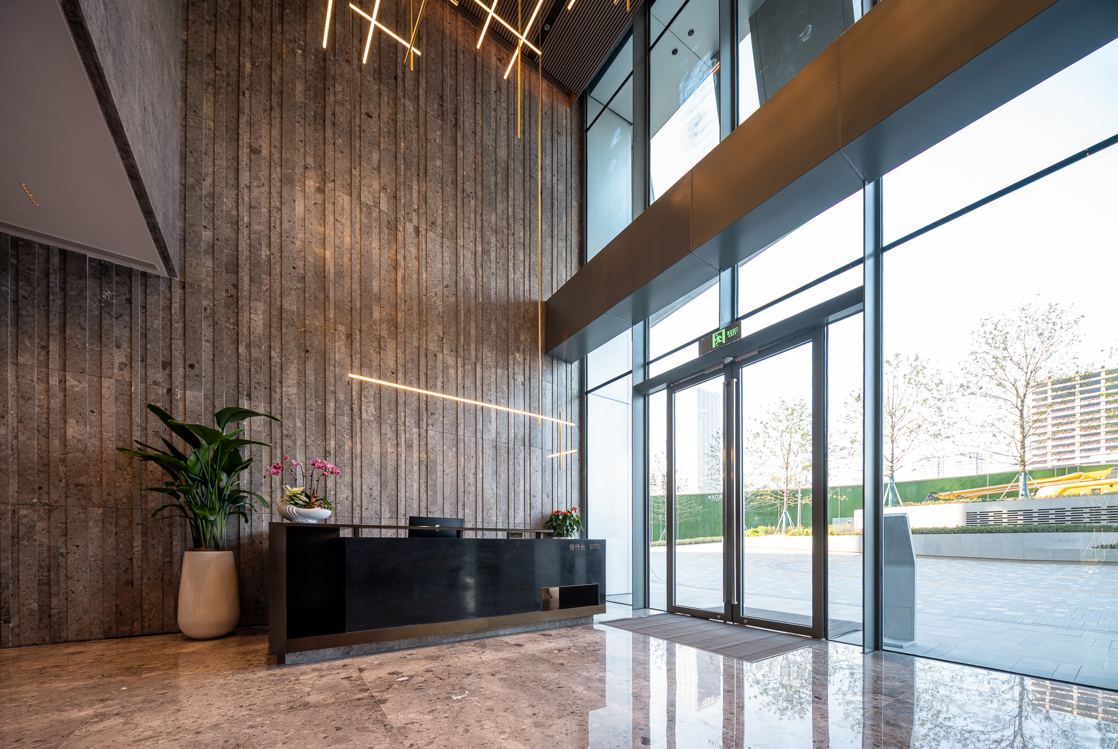
Before & After

Slide 5
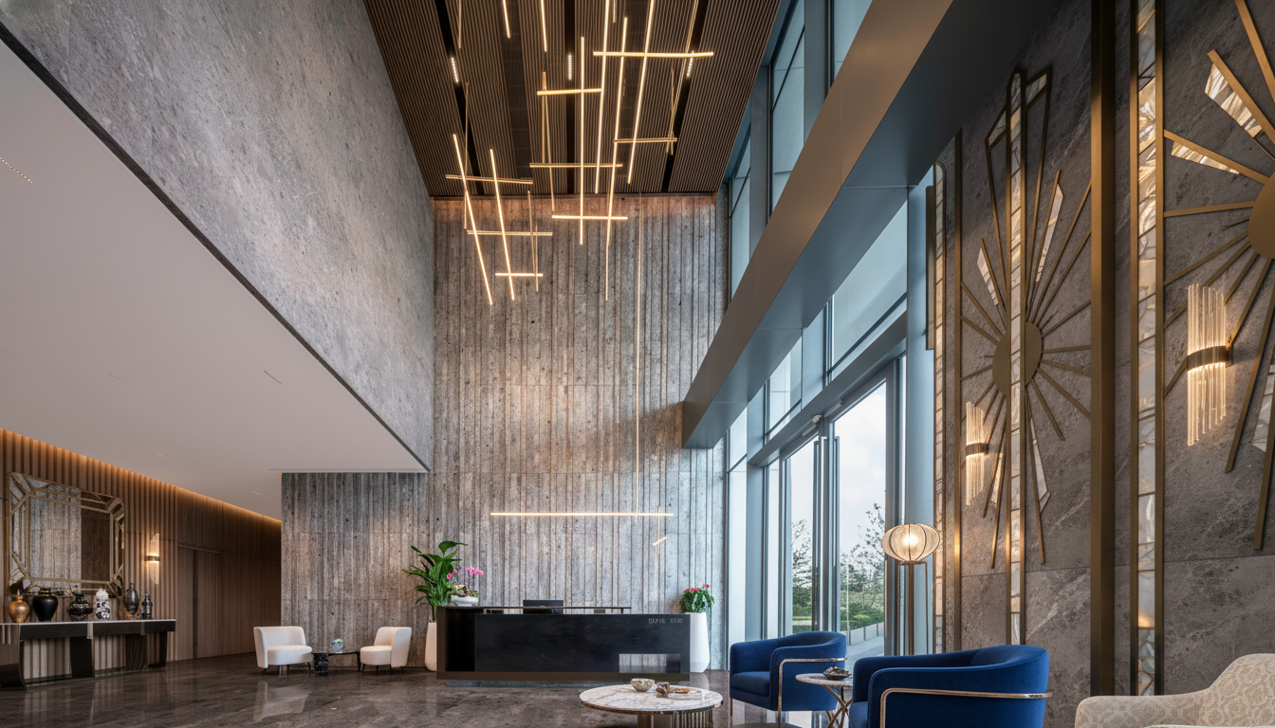
Before & After Design Style: Art Deco Accent

Slide 6
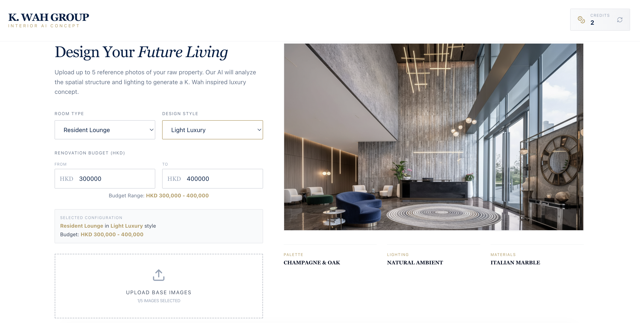
Application

